Slide 1
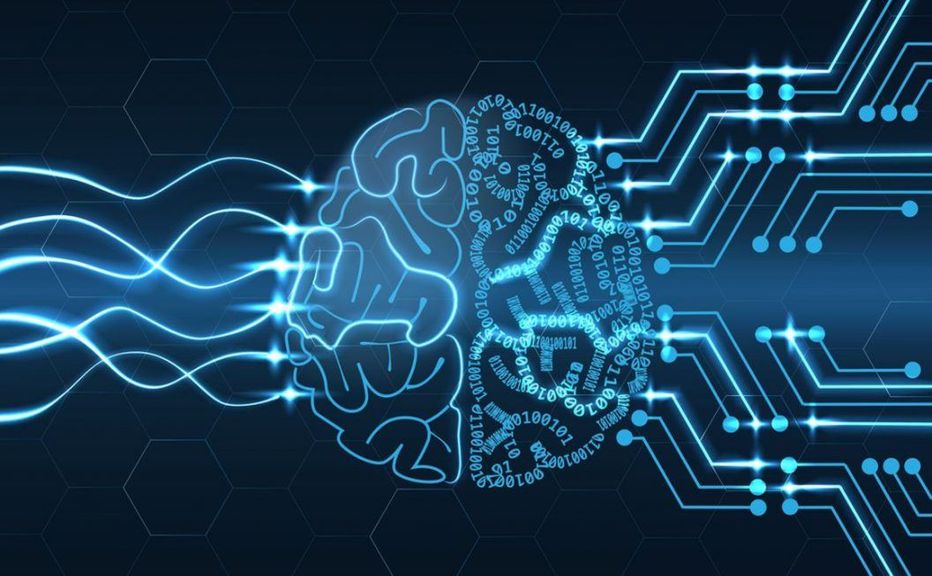
인공지능 기계학습 심층학습
https://iq.intel.co.uk/cognitive-computing-vs-artificial-intelligence/
김태형, 공학박사
Notes:
4차산업혁명 대비 전문가 릴레이 특강
TODO
결론을 첫 슬라이드에 넣는다.
ML Approaches의 슬라이드 삽입
DL 소개 슬라이드 업데이트
NLP 소개 슬라이드 업데이트
기타 분야 소개 슬라이드 추가
1

Slide 2
1.1. 인공지능의 소개: 기본 개념과 발전 방향
키워드
• 인공지능 (Artificial Intelligence, AI)
• 기계학습 (Machine Learning, ML)
• 심층학습 (Deep Learning, DL)
Notes:
∵ AI, 기계학습, 머신러닝, 딥러닝, 심층학습, 인공신경망, CNN, RNN...
1

Slide 3
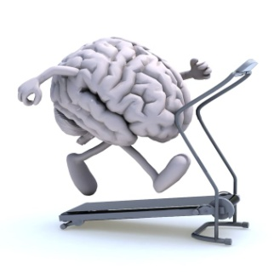
Definition of Artificial Intelligence
Formal definition Dartmouth Artificial Intelligence Conference (1956)
Every aspect of learning or any other feature of intelligence can in principle be so precisely described that a machine can be made to simulate it.
뇌가 수행하는 기능, 특히 지능을 요하는 능력,을 컴퓨터가 수행하는 것.
[Your Brain on Exercise, Anja Garcia]
Notes:
1

Slide 4
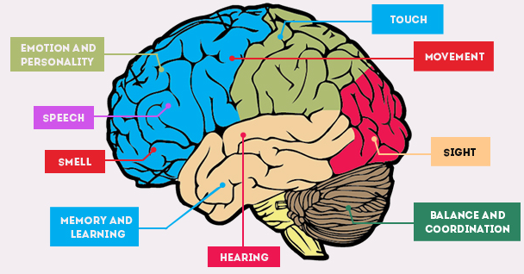
AI ~ 뇌가 수행하는 기능, 특히 지능을 요하는 능력,을 컴퓨터가 수행하는 것.
FRONTAL LOBE ?
TASTE
FACIAL RECOGNITION
/VISION
[Interesting Brain Facts for Kids - Fun Facts About Human Brain]
예:
뇌가 수행하는 기능
지능을 요하는 능력
감정
보행
언어 (외국어)
오감
지식
얼굴인식
게임
미각
청각
학습
체스
스타
크래프트
촉각
후각
시각
바둑

Slide 5
Machine Learning
Formal definition
Tom M. Mitchell
• A computer program is said to learn from experience E with respect to some class of tasks T and performance measure P if its performance at tasks in T, as measured by P, improves with experience E.
What is learning?
Relationship
Input
Output
f(X)
X
Y

Slide 6
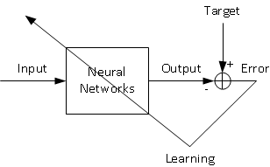
Artificial Neural Networks =a Nonlinear Function Approximator
The weights of ANN are learned by training the network.
Y
^ f: X→Y
E
X
^ Y
The network is a black box.

Slide 7
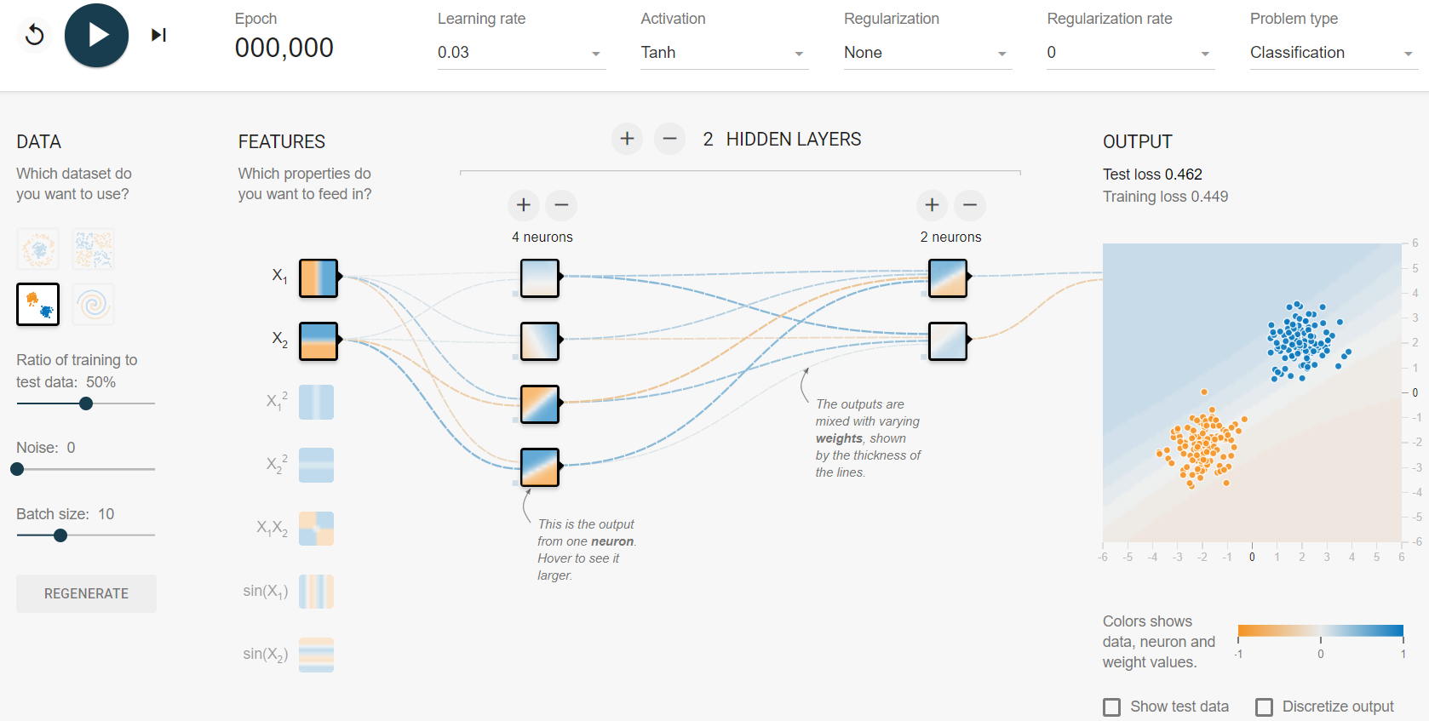
Visualization of the Classification Results
http://playground.tensorflow.org

Slide 8

Artificial Intelligence ⊇ Machine Learning ⊇ Deep Learning
ARTIFICIAL NEURAL NETWORKS
[What’s the Difference Between Artificial Intelligence, Machine Learning, and Deep Learning?, NVIDIA]
Artificial neural networks are the key to the current AI boom.
Notes:
Keytakeaways
1

Slide 10
1.3. 인공지능의 소개: 최근 주요 역사
Notes:
1

Slide 11
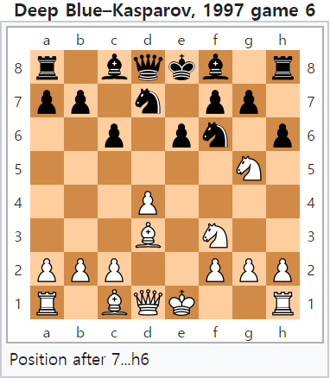
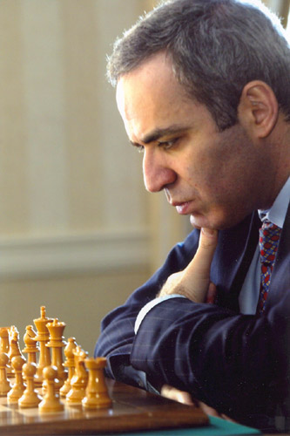
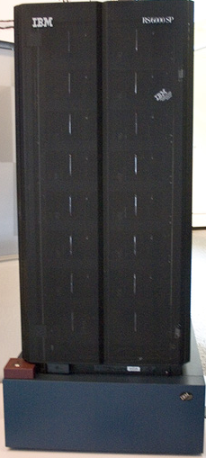
Game of Chess: IBM Deep Blue Defeats Garry Kasparov (1997)
IBM’s super computer Deep Blue defeated human chess champion Garry Kasparov in 1997.
Deep Blue versus Garry Kasparov, Wikipedia
Notes:
1997년 Human Chess Champion인 Garry Kasparov가 IBM의 Deep Blue에 패배를 합니다.
Impact를 설명.
1

Slide 12
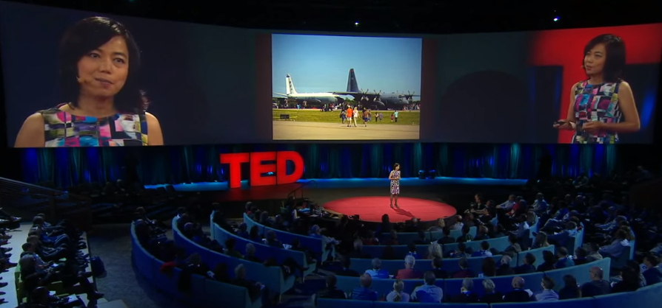
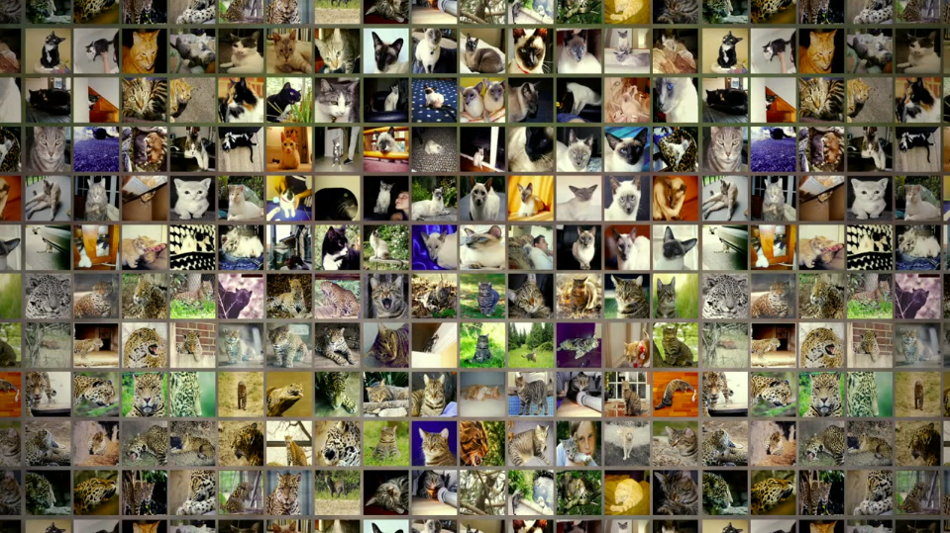
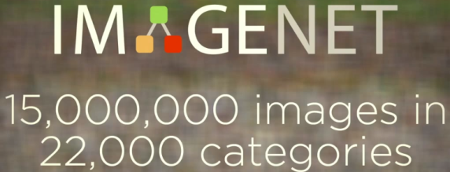
ImageNet: Huge Image Data (2009)
The database of 15 million images in 22k categories was delivered to Conference on Computer Vision and Pattern Recognition (CVPR) in 2009.
The ImageNet project runs an annual software contest from 2010.
What I learned from competing against a ConvNet on ImageNet, Andrej Karpathy
How we teach computers to understand pictures | Fei Fei Li, TED
Notes:
Standford의 Feifei Li가 ImageNet이라는 다량의 이미지 데이터베이스를 구축합니다.
CVPR이라는 학회에서는 ImageNet을 이용한 computer vision분야의 annual contest를 시행하구요.
데이터가 많아야 하는데, 이미지 나중에 기여한다.
1

Slide 13

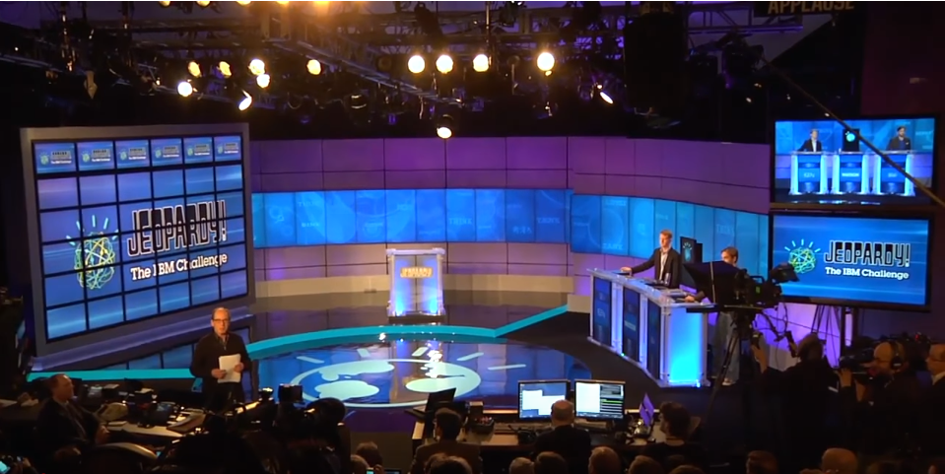
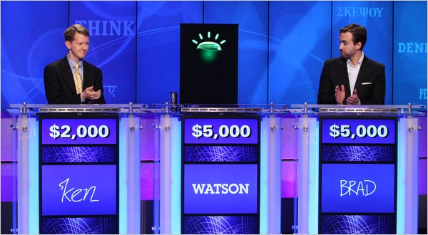
Jeopardy!: IBM Watson Wins on Jeopardy (2011)
IBM’s Q&A system won the game with $77,147 leaving Two “Jeopardy!” champions Rutter and Jennings with $21,600 and $24,000 respectively.
IBM's Watson Supercomputer Destroys Humans in Jeopardy | Engadget
Computer Wins on ‘Jeopardy!’: Trivial, It’s Not, the New York Times
IBM Watson: The inside story of how the Jeopardy-winning supercomputer was born, and what it wants to do next, IBM
Notes:
미국 주요 병원에서 암진단 및 치료법 조언 (2013)
진단서 60만건, 전문서적 200만쪽, 환자기록 150만명분 학습
폐암 진단 정확도 Watson 90%, 의사 50%
대장암 98%, 방광암 91%, 췌장암 94%, 자궁경부암 100% (미국 종양학회)
DNA 분석을 통한 질병 예측 및 맞춤형 치료
2016년 11월 ExoBrain – EBS 장학퀴즈
자연어 질의응답: 자연어 이해, 지식학습 기술
시즌 1 우승자, 시즌 2 우승자, 수능 만점자와 대결
1

Slide 14
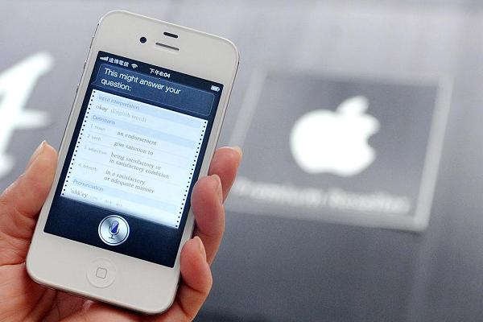
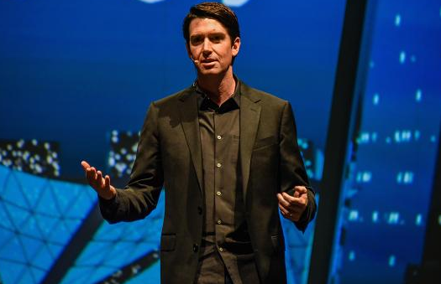
Intelligent Personal Assistant: Apple Launches Siri (2011)
Siri was launched as an app in the Apple store in February, 2010.
The Siri team sold it to Apple in April, 2010.
Siri was launched on the iPhone on Oct. 4, 2011. (Jobs died the next day.)
Adam Cheyer, co-founder of Siri Inc. and Viv Labs
Here's how Siri made it onto your iPhone, CNBC
Notes:
NLP에
사람의 뇌 어떤 분야인가 귀와 입을 하는 역할을 해석하는 부분에 지능이 있다.
1

Slide 15
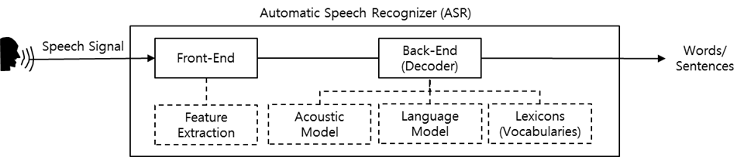
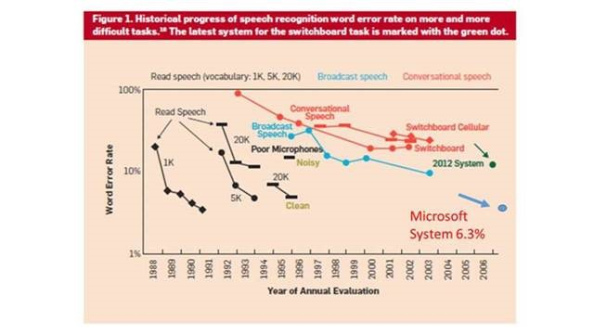
Microsoft Research’s Speech Recognition Breakthrough (2012)
Microsoft researchers achieve speech recognition milestone, Microsoft Blog

Slide 16
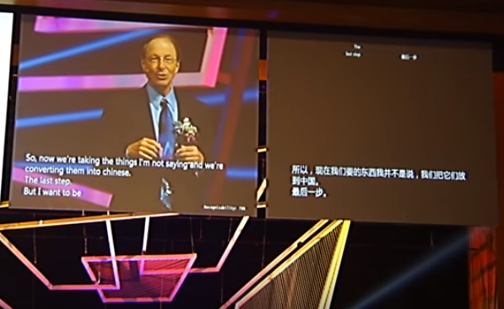
Microsoft Research’s Speech Recognition Breakthrough (2012)
Real-time machine translation from English to Chinese followed by automatic speech recognition with deep learning technique
Speech Recognition Breakthrough for the Spoken, Translated Word, Nov 8, 2012 , Microsoft Research
Notes:
Microsoft Rick Rashid (라쉬~드)
The speech recognition breakthrough via machine translation was demonstrated by Rick Rashid, Chief Research Officer, to Chinese students. English was turned to Mandarin in real time with corresponding transcriptions.
Deep neural networks improved the performance of automatic speech recognition.
Microsoft Research and University of Toronto collaborated to improve the performance of automatic speech recognition with deep neural networks.
1

Slide 17
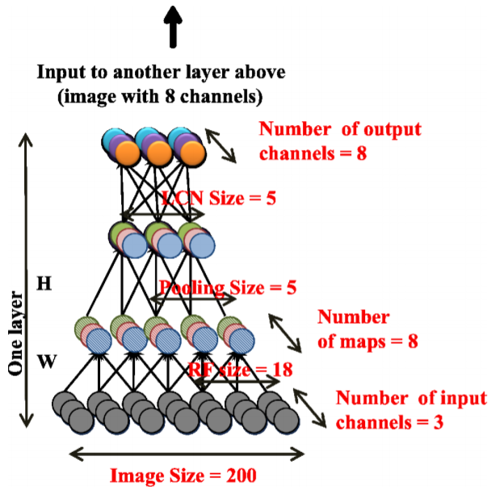
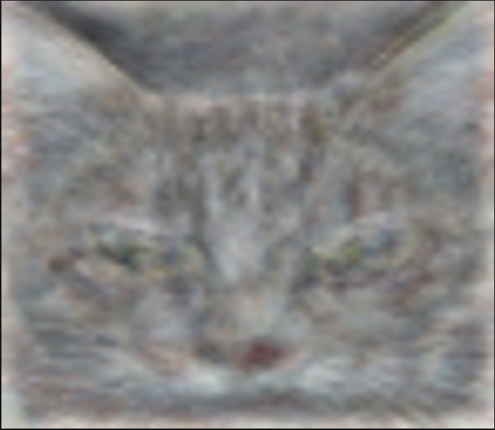
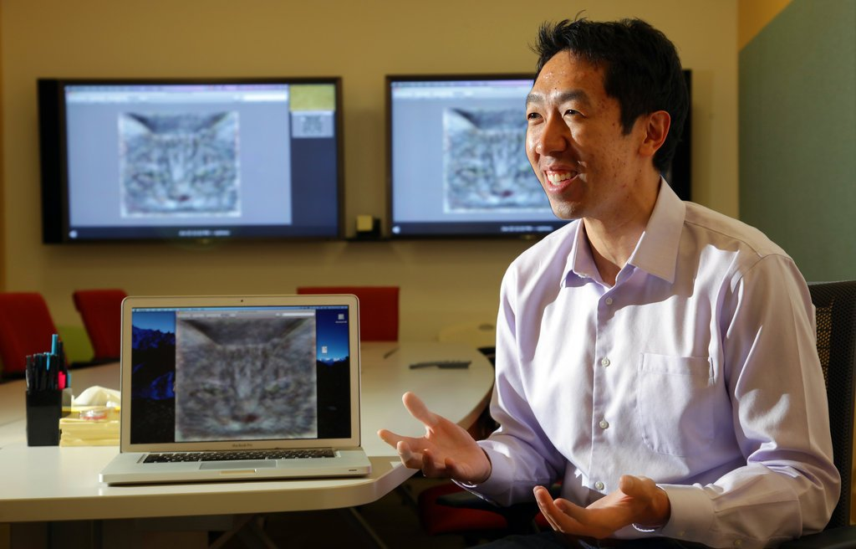
Google X Creates a Large Scale Neural Network (2012)
In July, 2012, Google X succeeded to tell a cat from unlabeled YouTube still images. (200 x 200 pixel thumbnails from 10 million still images of YouTube videos)
The neural network is trained on a cluster of 1,000 computers with 16,000 CPU cores.
Building High-level Features Using Large Scale Unsupervised Learning, Le. et. al.
Andrew Y. Ng, a Stanford computer scientist, is cautiously optimistic about neural networks., The New York Times

Slide 18
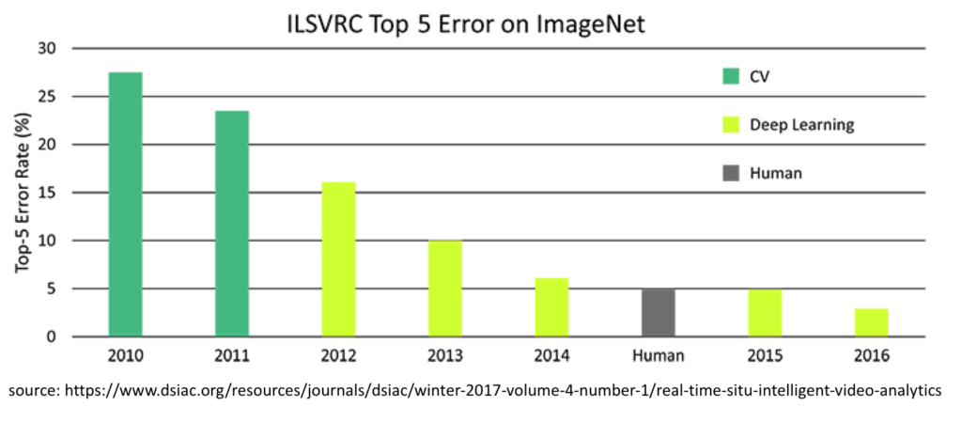
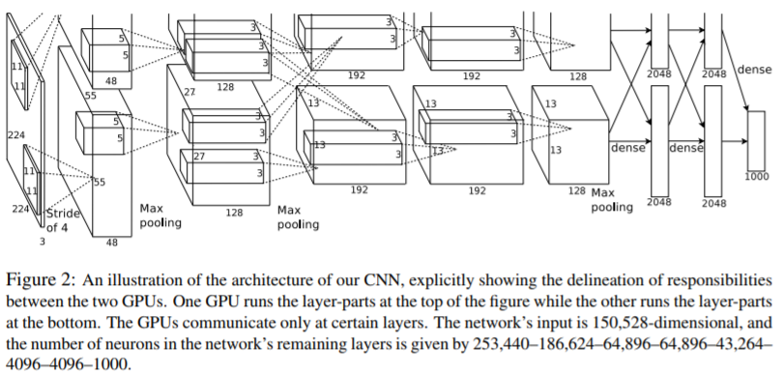
AlexNet Wins the ImageNet Competition (2012)
Alex Krizhevsky et. al. (University of Toronto)
AlexNet is a CNN with 8 layers (5 convolutional layers followed with fully connected layers)
15.3%
Factors that have triggered the potential of Deep Learning, Jordi Torres
ImageNet Classification with Deep Convolutional Neural Networks, Alex Krizhevsky, Ilya Sutskever, Geoffrey E. Hinton
Notes:
University of Toronto의 Alex Krizhevsky가
1

Slide 19
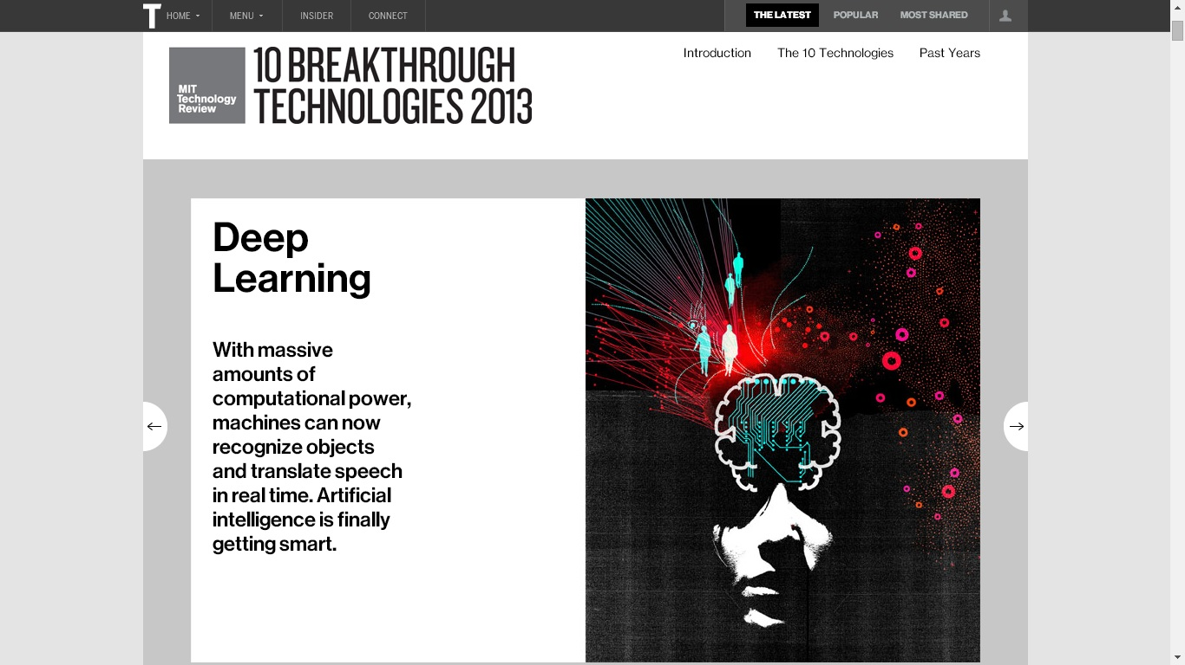
Scope: Artificial Intelligence ⊂ Machine Learning ⊂ Deep Learning
Source: What’s the Difference Between Artificial Intelligence, Machine Learning, and Deep Learning? Michael Copeland
Deep Learning, Robert D. Hof
Notes:
Deep Learning이 각광을 받았다.
내 얘기 그 전에는 NN 안쓴다 였는데, 이를 경계로 DL이 잘 된다는 인식이 생겼다.
DL도 쓸만한 알고리즘이라는 패러다임 시프트가 됐다.
1

Slide 20
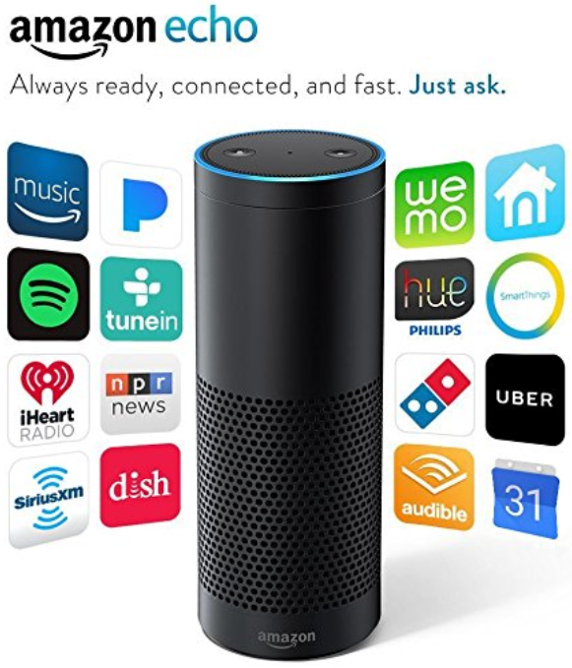
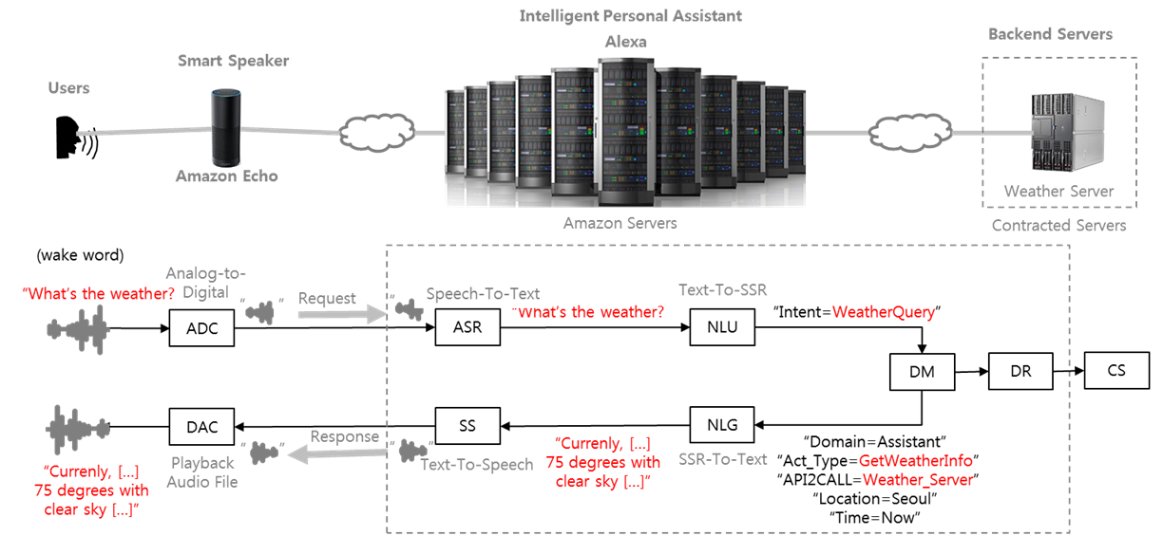
Smart Speaker: Amazon Releases Echo with Alexa (2014)
Amazon Echo with Alexa opens a new era for an intelligent personal assistant device.
Official Website Amazon
Notes:
상용서비스와 연계된 그나마 성공한...
인식률이 잘 되었지만, 불을 짚혔다.
Trend
Acronyms
ADC (Analog-to-Digital Conversion)
ASR (Automatic Speech Recognition)
NLU (Natural Language Understanding)
SSR (System-specific Semantic Representation)
DM (Dialog Manager)
DR (Domain Reasoner) or Back-end
NLG (Natural Language Generation)
SS (Speech Synthesis)
DAC (Digital-to-Analog Conversion)
1

Slide 21
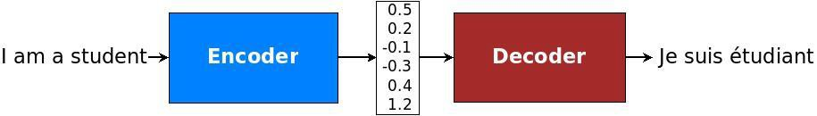

Machine Translation: RNN Encoder-Decoder Architecture (2014)
Cho et.al. from Universite de Montr´eal proposed Recurrent Neural Network (RNN) Encoder-Decoder Architecture.
Learning Phrase Representations using RNN Encoder–Decoder for Statistical Machine Translation, Cho et.al.
The magic of LSTM neural networks
Notes:
여러분들 번역기 잘 쓰시죠?
요즘에 구글 번역기가 더 좋아졌죠? 왜 좋아졌을까요?
예전에는 통계적인 기법을 쓰다가 neural network를 썼다.
번역기 성능이 좋아졌다.
1

Slide 22

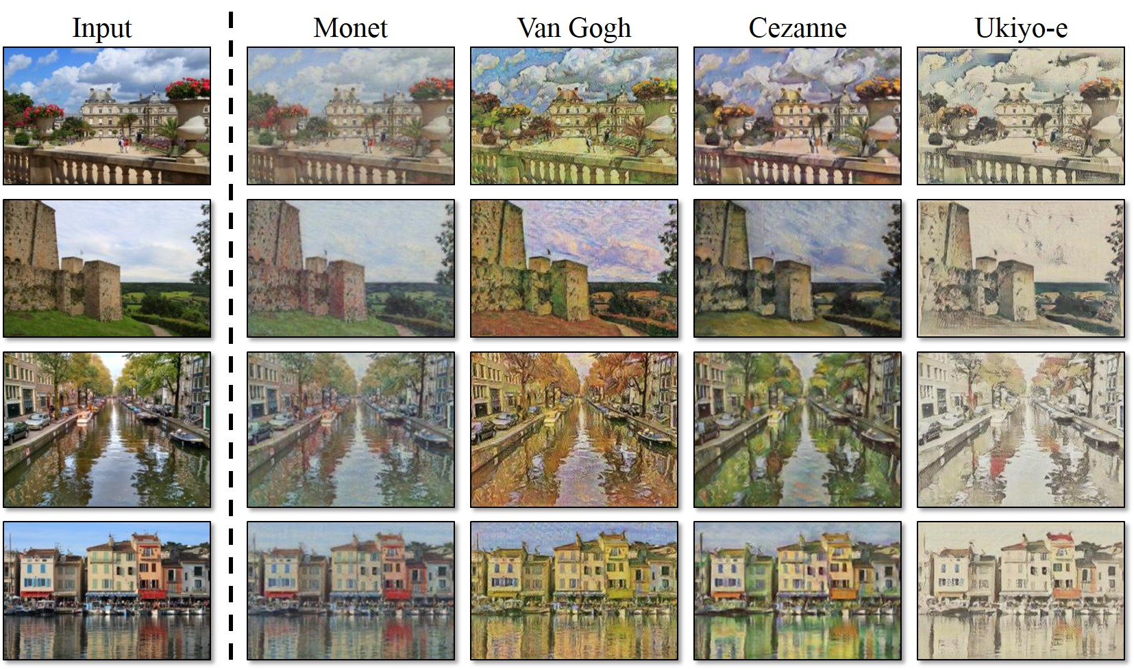
Generative Adversarial Networks (GANs) (2014)
Ian Goodfellow et. al. at the University of Montreal, including Yoshua Bengio proposed GAN.
GAN: A Beginner’s Guide to Generative Adversarial Networks, deeplearning4j
https://github.com/junyanz/CycleGAN
Notes:
More than 100 variants.
1

Slide 23
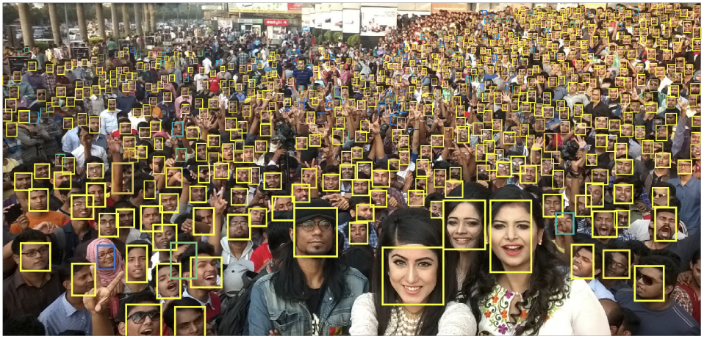
Facebook DeepFace (2014)
Deep learning facial recognition system achieved 97.35% accuracy (Human 97.5%)
“Pretty convincingly solved face recognition,” Ben Goertzel (Wikipedia-DeepFace)
Data Set
- Training: 4 million facial images from more than 4k identities (Facebook Data)
- Test: LFW (Labeled Faces in the Wild) dataset
Network
- 9 hidden layers with more than 120 million connection weights
https://blog.goodaudience.com/a-year-in-computer-vision-part-1-of-4-eaeb040b6f46
DeepFace: Closing the Gap to Human-Level Performance in Face Verification, facebook research
Notes:
요즘 얼굴에 태그 달리죠. 그것도 neural net입니다.
1

Slide 24

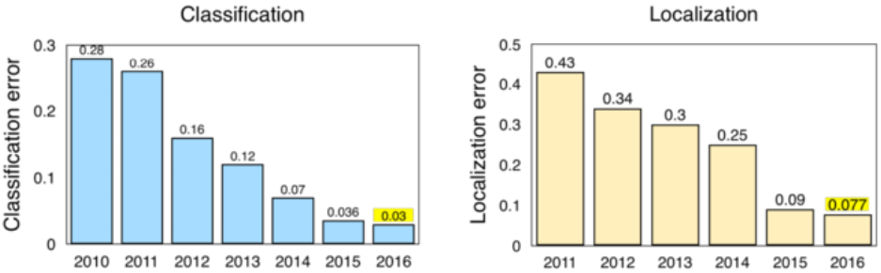
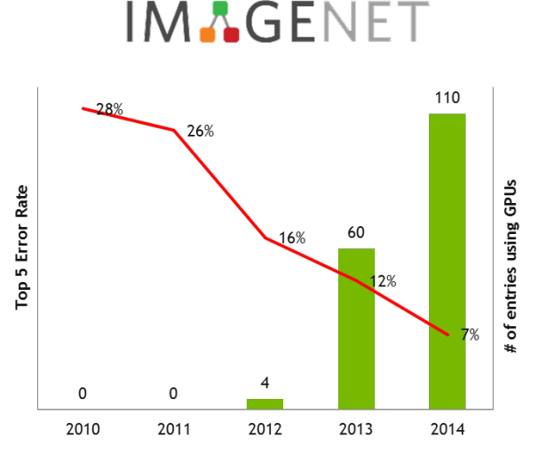
ImageNet Challenge Results Surpass Human Level (2015)
Source: Stanford CS231n
A Year in Computer Vision
NVIDIA and IBM Cloud Support ImageNet Large Scale Visual Recognition Challenge, NVDIA Developer

Slide 25

Google Open-Sources Its Deep Learning Framework (2015)
Notes:
Jeff Dean
Open source 누구나 딥러닝을 할 수 있게 되었다.
1

Slide 26
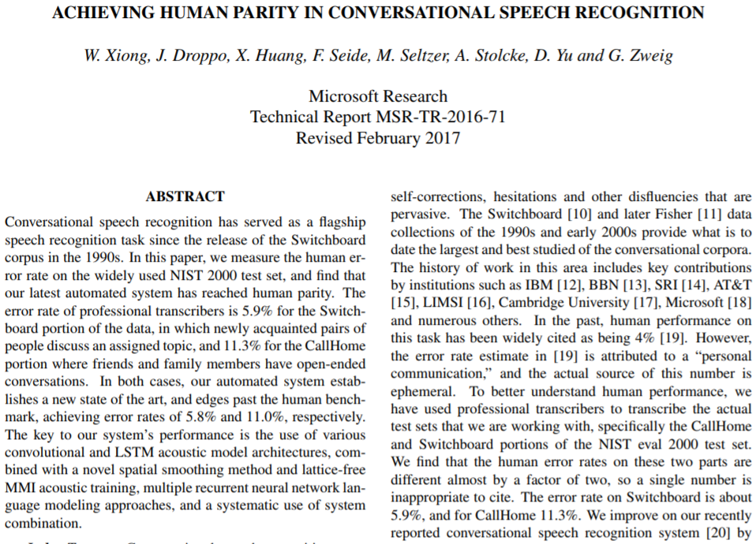
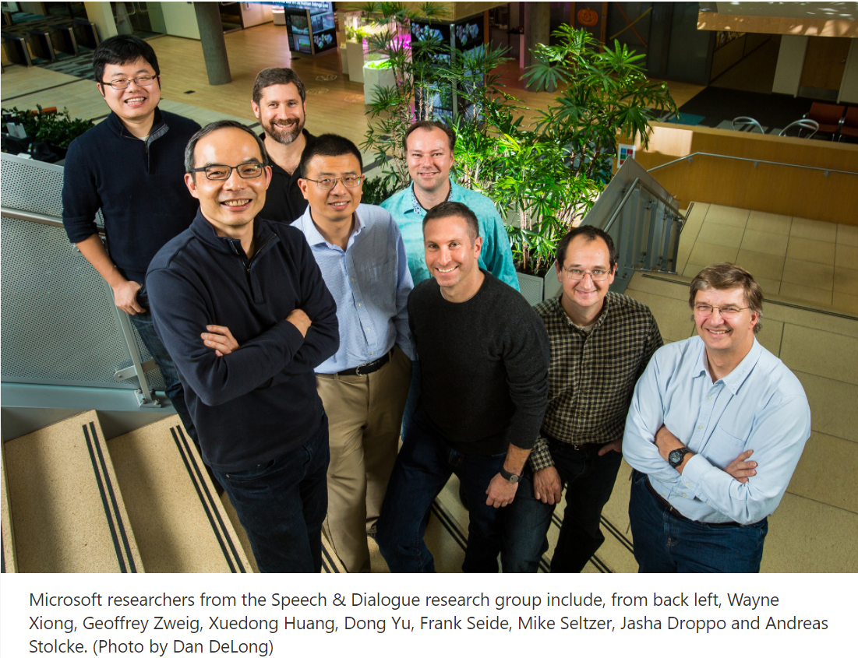
Microsoft’s Speech Recognition Reaches Human Parity (2016)
Historic Achievement: Microsoft researchers reach human parity in conversational speech recognition, Oct 18, 2016, Allison Linn

Slide 27
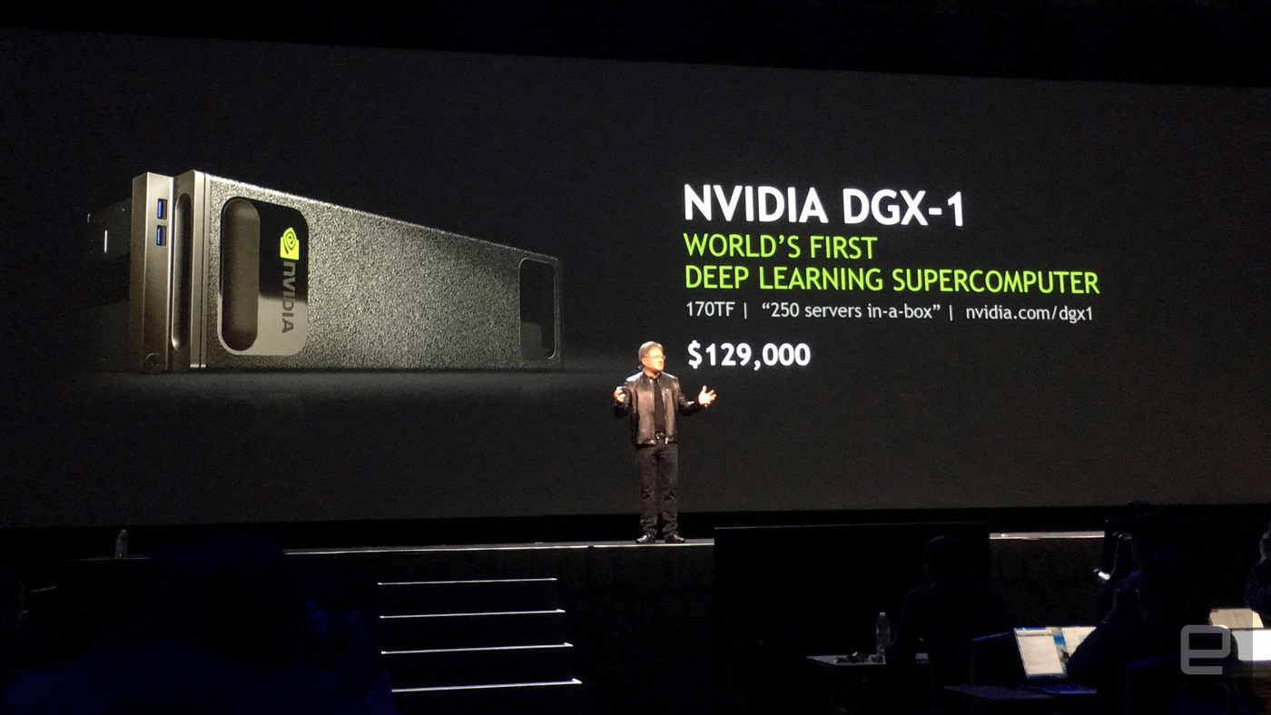
NVIDIA Launches Deep Learning Supercomputer (2016)
NVIDIA's insane DGX-1 is a computer tailor-made for deep learning, engadget
Notes:
다량의 데이터를 처리하기 위해선 빠른 하드웨어가 필요합니다.
1

Slide 28
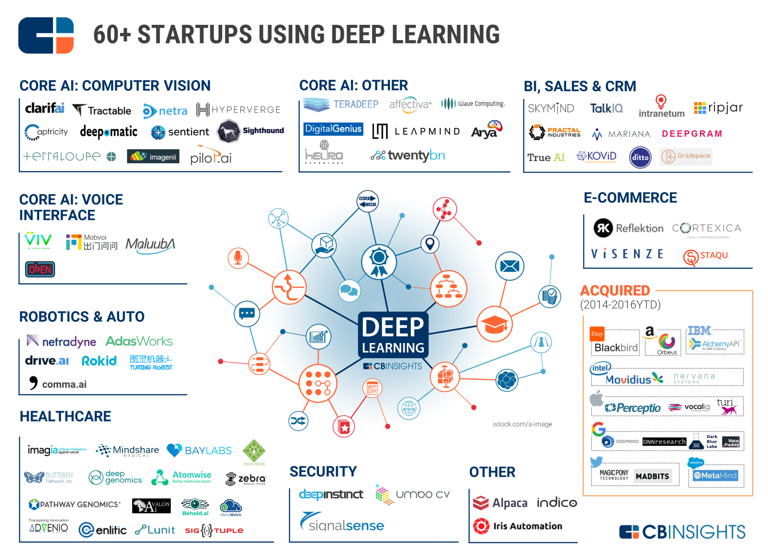
Deep Learning Startups Work Across Various Domains (2016)
https://www.cbinsights.com/research/deep-learning-ai-startups-market-map-company-list/

Slide 29
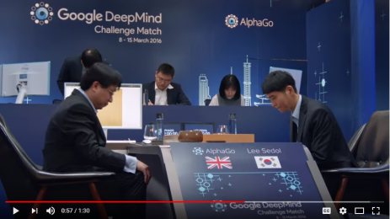
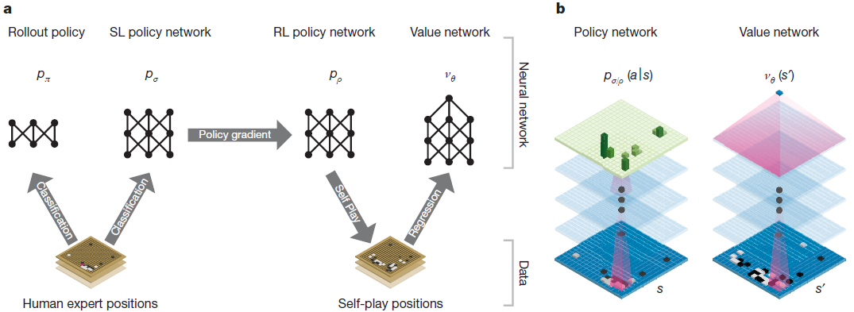
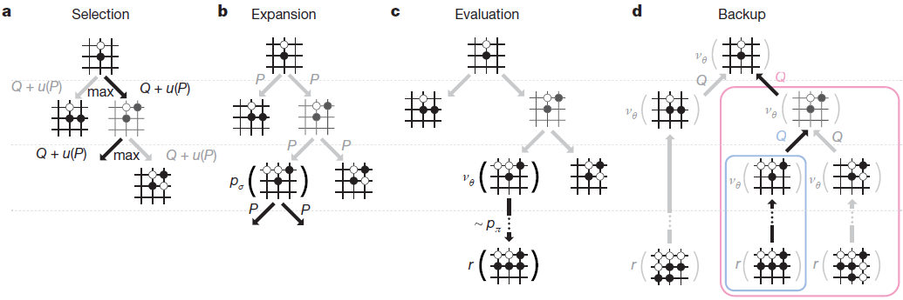
Computer Go: DeepMind’s AlphaGo Defeats Sedol Lee (2016)
AlphaGo Official Trailer [1:30]
Mastering the game of Go with deep neural networks and tree search, Nature
Notes:
초등학생까지 딥러닝이라는 단어를 알게 된게 이때입니다.
1

Slide 30
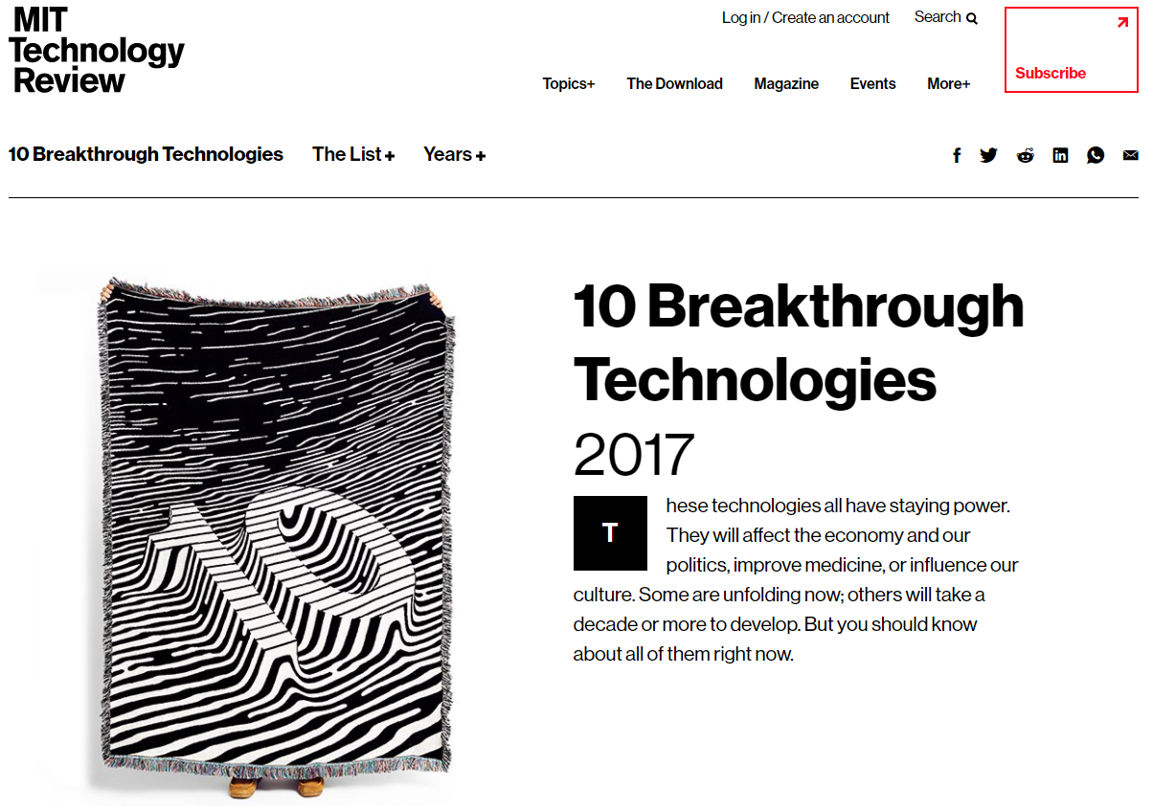
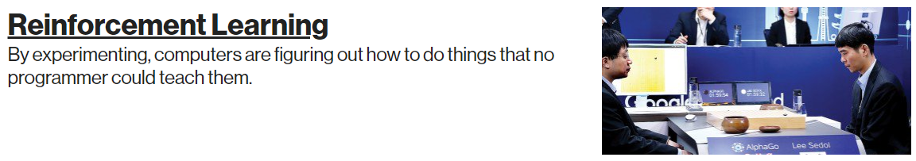
10 Breakthrough Technologies 2017, MIT Technology Review

Slide 31
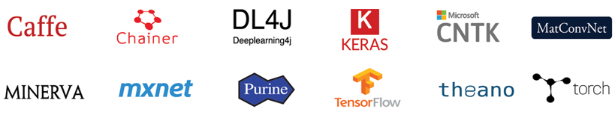
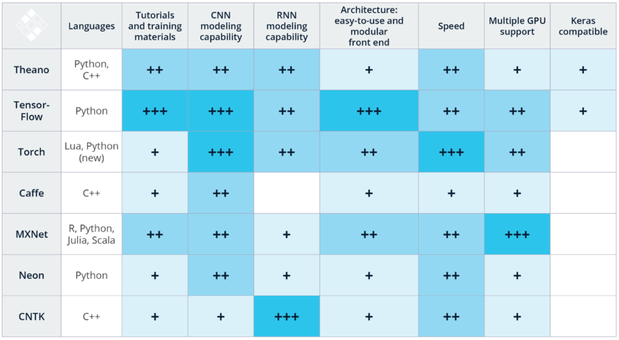
Open Source Deep Learning Framework War (2017)
Deep Learning Software, NVIDIA
Open-Source Deep Learning Frameworks and Visual Analytics, DZone
Notes:
TensorFlow가 다가 아닙니다.
목적과 용도에 맞게 이렇게 다양한 프레임워크가 존재합니다.
춘추전국시대
1

Slide 32
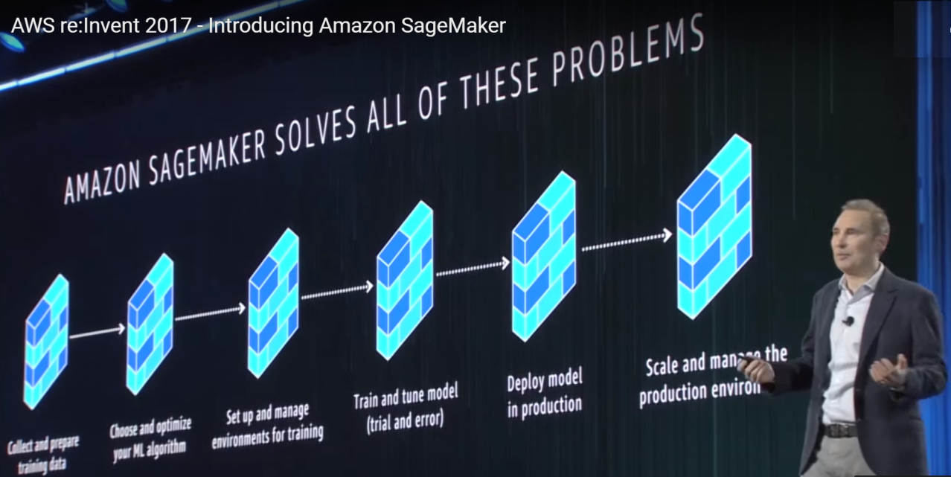
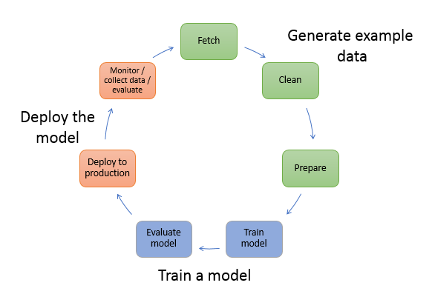
Amazon SageMaker (2017)
Andy Jessy introduces a fully-manage service for machine learning at AWS re:Invent 2017.
AWS re:Invent 2017 - Introducing Amazon SageMaker, Amazon Web Services
Machine Learning with Amazon SageMaker, AWS Documentation
Notes:
보편화. 진입장벽 낮춰서 딥러닝 연구자가 아닌 일반 개발자도 쓸수 있도록 진입장벽을 낮췄다.
데이터사이엔티스트들은 데이터를 만지고, 박사는 알고리즘만 알고, 운용부서 등도...
플랫폼 구축하는 사람 별개로 있었고...
딥러닝
데이터가 많아야하고, 좋은 알고리즘을 만들어야 하고, 고사양의 하드웨어가 필요했다.
돈있는 연구기간과 잘 교육받았던 사람입니다.
구글이 프레임을
하드웨어 가격/배포까지 자유롭게...
1

Slide 33
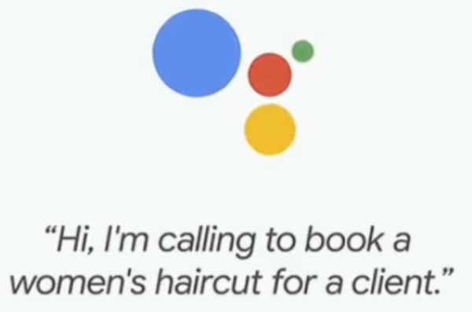
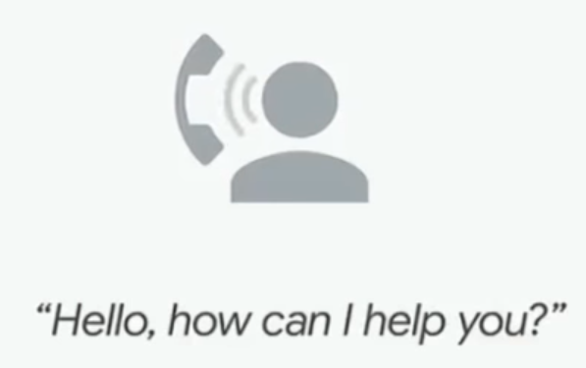
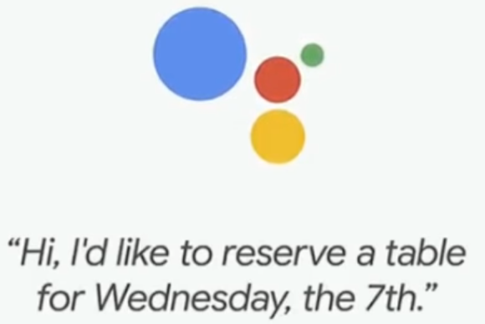
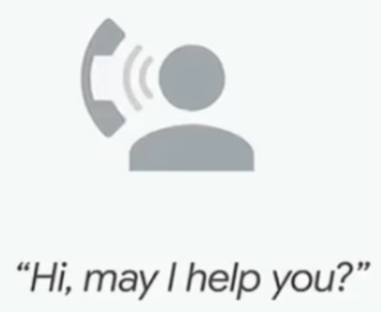
Google Assistant: Duplex (2018)
@Google I/O 2018, May 8
Play the video at https://youtu.be/D5VN56jQMWM?t=1m10s [1:10~end]
Google Duplex
Hair Salon
Restaurant
[Google Duplex: A.I. Assistant Calls Local Businesses To Make Appointments]
Notes:
There are endless ways that an RNN can connect back to itself with recurrent connections. People typically stick to a few common patterns, the most common being Long Short-Term Memory (LSTM) cells and Gated Recurrent Units (GRU). These both have multiplicative gates that protect their internal memory from being overwritten too easily, allowing them to handle longer sequences. We use LSTMs in this model. To learn more about RNNs and specifically LSTMs, check out Chris Olah’s fantastic post. Experts in the field might also like to look at Goodfellow, Bengio and Courville’s RNN chapter from their book “Deep Learning.”
1

Slide 35
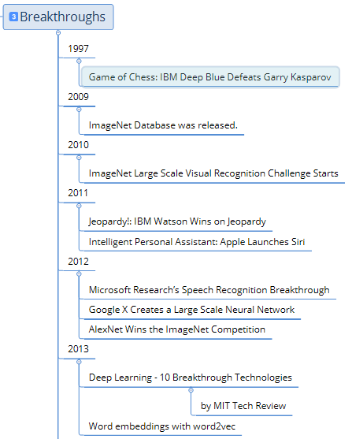
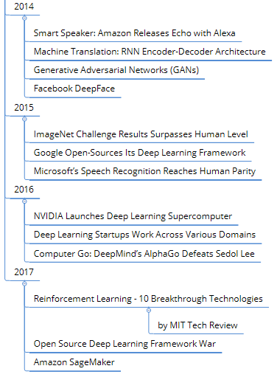
Notes:
1

Slide 36



Future Directions
More Hardware
More
Human-like Features
Alan Turing
(Wikipedia)
Deep
Learning
Intelligent Personal Assistant
Natural Language Processing
Smart Speaker
Academia
Industry

Slide 37






Artificial Intelligence/Deep Learning in Production
Autonomous Driving
(Real-Time Object Recognition)
Speech Recognition
(+NLP)
Computer Go
How Google self-driving car sees a road [0:50]
AlphaGo Official Trailer [1:30]
All-New Amazon Echo [1:52]
Computer Vision
Recommender Systems
emotional control
behavioral control
attention
social skills
judging
organizing
reasoning
planning
strategizing
decision making
How computers learn to recognize
objects instantly, Joseph Redmon [7:37]
Robotics
Q&A System
Interesting Brain Facts for Kids - Fun Facts About Human Brain
Machine Translation
Atlas, The Next Generation [2:41]
Watson and the Jeopardy! Challenge [3:45]

Slide 38


Representative Areas of Studies in Deep Learning
Etc
Type
of
Data
Imagine there's no heaven. [...]
Digital Signal
Processing
Field
of
Study
Speech/Audio
Signal
Processing
Image/Video
Signal
Processing
Natural Language Processing
Speech
Computer Vision
Estimation/
Prediction
Deep Learning
Machine Learning
Artificial Intelligence
Notes:
1

Slide 39

Speech Recognition+Natural Language Processing
All-New Amazon Echo [1:52]

Slide 40





Auditory Cortex: Language Areas of the Brain
We understand
Primary Auditory Cortex
Brodmann areas 41 & 42
(Speech Recognition)
We generate
We listen
Learning to speak bird, PEANUTS
We speak
Language Areas of the Brain, NeuroLove

Slide 41
Natural Language Processing (1/2)
Natural Language Processing (NLP) (= Human Language Processing)
• is an area of computer science and artificial intelligence • concerned with the interactions between computers and human (natural) languages, • in particular how to program computers • to fruitfully process large amounts of natural language data.
[Natural-language_processing, Wikipedia]
We listen
We understand (language)
We speak
We generate (language)
Learning to speak bird, PEANUTS

Slide 42
Natural Language Processing (2/2)
Challenges • in natural-language processing frequently involve
• speech recognition, natural language understanding, and natural language generation.
[Natural-language_processing, Wikipedia]
Speech Processing
Text Processing
(Automatic) Speech Recognition (ASR)
Natural Language Understanding (NLU)
We listen
We understand
Speech Synthesis
Natural Language Generation (NLG)
We speak
We generate
Learning to speak bird, PEANUTS

Slide 43
Natural Language Processing: Scope 1
Introduction to Natural Language Processing - Cambridge Data Science Bootcamp
AI
NLP is a part of AI.
Recent trend is to apply Machine/Deep Learning.
NLP
ML/DL
NLP is a field of computer science and
computational linguistics.

Slide 44
Natural Language Processing: Scope 2
Natural Language Processing
Artificial
Intelligence
Linguistics
NLP is a part of AI.
Recent trend is to apply Machine/Deep Learning.
ML/DL
[A Panorama of Natural Language Processing, Ted Xiao]
Notes:
“NLP is a field of computer science and computational linguistics.”
This doesn’t have to be explained because NLP and computational linguistics are interchangeable.
Ted Xiao, Research Engineer at Google Brain
1

Slide 45
Natural Language Processing vs. Computational Linguistics
Natural Language Processing (NLP) and Computational Linguistics (CL) are often used interchangeably.
Natural Language
Processing
Computational Linguistics
Field
of
Study
Computer Science
Linguistics
Education
Machine/ Deep Learning
Neuroscience
(Recent trend)
Solving engineering problems that analyzes or generates text in natural language
Asking what humans are computing and how for communicating each other
Fundamental
Difference
What are the fundamental differences between Natural Language Processing and Computational Linguistics? Quora.com

Slide 46
Speech Recognition+Natural Language Processing
All-New Amazon Echo [1:52]

Slide 47
NLP Smart Speaker as a Spoken Dialog System
(wake word)
“What’s the weather?
Analog-to-
Digital
Speech-To-Text
Text-To-SSR
“ ”
Request
“ ”
“What’s the weather?
“Intent=WeatherQuery”
ADC
ASR
NLU
DM
DR
CS
DAC
Response
SS
NLG
“Domain=Assistant”
“Act_Type=GetWeatherInfo”
“API2CALL=Weather_Server”
“Location=Seoul”
“Time=Now”
“ ”
“ ”
“Currenly, […] 75 degrees with clear sky […]”
“Currenly, […] 75 degrees with clear sky […]”
Playback Audio File
Text-To-Speech
SSR-To-Text
Images from Server Systems, HPE Integrity Servers, Storage And Servers, Iconizer.net
Front end
(Language Areas)
Back end
We read
FRONTAL LOBE ?
TASTE
FACIAL RECOGNITION
We write
We listen
Learning to speak bird, PEANUTS
feelings
/VISION
We speak
Language Areas of the Brain, NeuroLove
ideas
Language Areas of the Brain, NeuroLove
[Interesting Brain Facts for Kids - Fun Facts About Human Brain]

